Slide 1
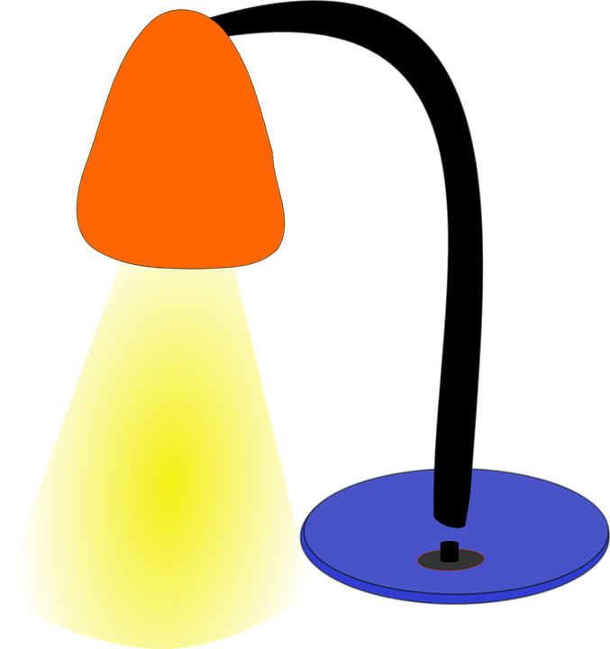

Light

Slide 2
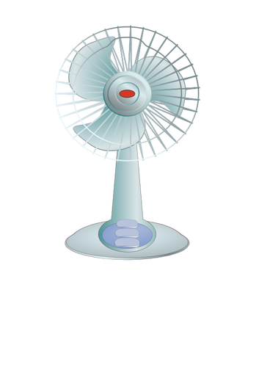
Fan

Slide 3
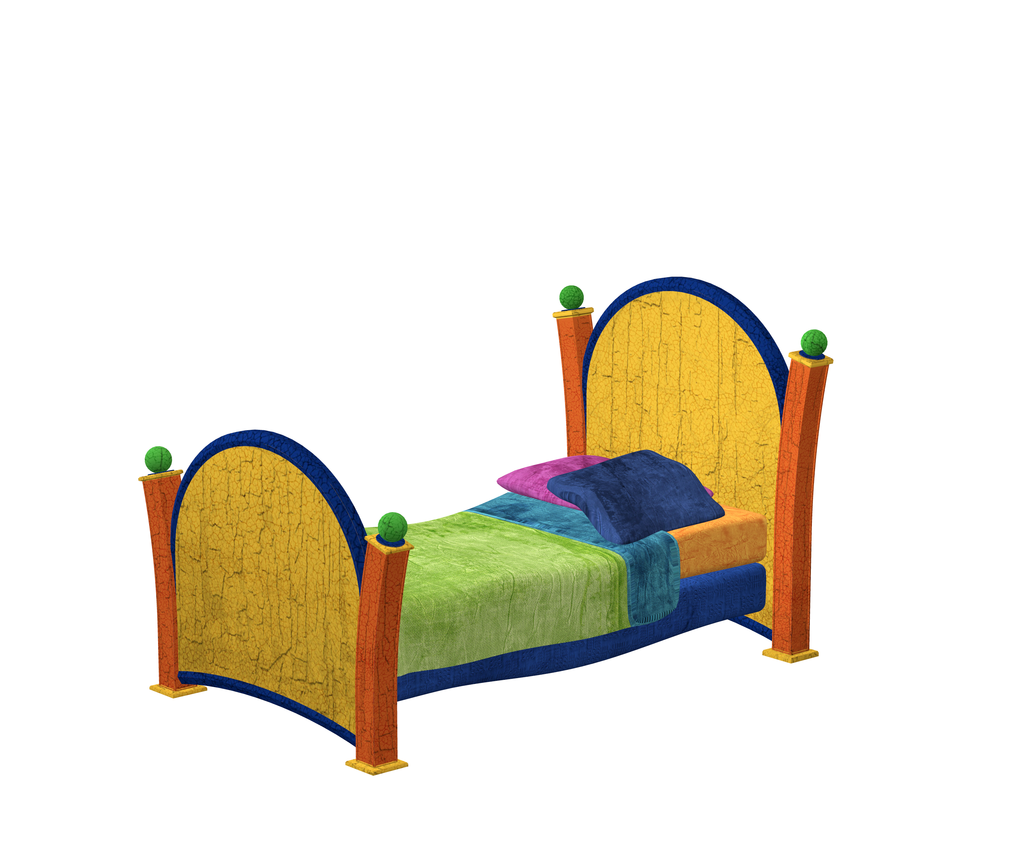
Bed

Slide 4

Key

Slide 5

Pillow

Slide 6

Cupboard

Slide 7

Plate/Dish

Slide 8

Clock

